Slide 1

CNC MACHINES AND AUTOMATION
AMIT JANGRA
Lecturer
Mechanical Engineering Department
GP HISAR

Slide 2
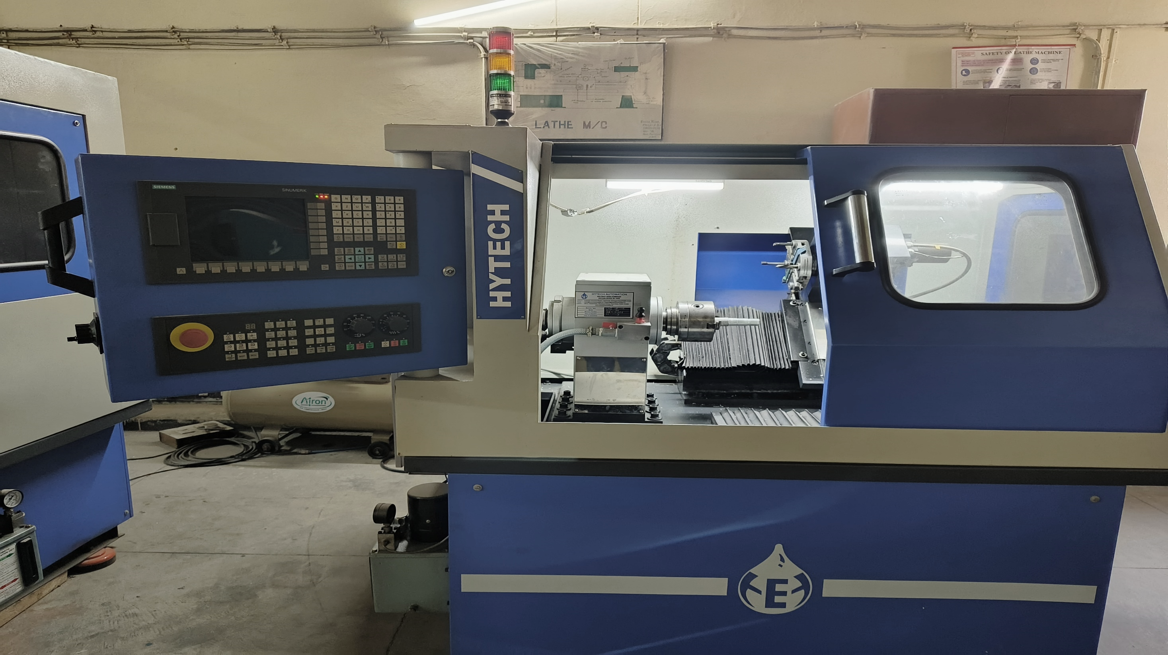
Chapter 4
(Part Programming)

Slide 3
Part Programming
The part program is a sequence of instructions, which describe the work, which has to be done on a part in the form required by a computer under the control of numerical control computer program.
Basic Concept of Part Programming
The coded instruction or commands in the form of numbers, alphabets and symbols listed in logical sequence and are fed to the controller unit of machine tool to perform a series of operations. This set of coded instruction is called part program.
Following steps are needed to perform while performing a part program:
Determine the start up procedure, which includes the extraction of dimensional data from part drawings.
Select the tool and determine the tool offset.
Set up the zero position for the work piece.
Select the speed and rotation of the spindle.
Set up the tool motions according to the profile required.
Return the cutting tool to the reference point after completion of work.
End the program by stopping the spindle and coolant.

Slide 4
Fundamental of Part Programming
Process planning
Axes selection
Tool selection
Cutting process parameter
Job and tool setup planning
Machining path selection
Part Program writing

Slide 5
Type of Part Programming
Planning Departmental Programming
Workshop Programming
Manual Programming
Computer aided programming
High level programming languages

Slide 6
Basic Terms of Part Programming
Part Program
Main Program and structure
Input unit
Coordinate system

Slide 7
NC words
n-words: - They denote the sequence number to identify the block. The complete word usually consist of three digits with ‘n’ as a prefix.
g-words: - These are called preparatory words i.e., the words used to prepare the controlling unit for the operating instructions, which are to follow.
x, y, z, a and b words: - They are knowns as coordinate words or dimension data words. The first three words x, y, z followed by actual dimensions, represent the coordinate position of tool along the three principal axis while the words ‘a’ and ‘b’ indicate the angular positions.
f-words: - These words carry the alphabet ‘f’ as prefix and may contain upto 8 digit maximum. They are used to specify feed rate in mm/min.
s-words: - These words carry the alphabet ‘s’ as prefix and specify cutting speed in rev./min of the spindle.
t-words: - These words carry the alphabet ‘t’ as prefix and may contain upto 5 digit maximum. They are known as tool selection words and used only for those NC machines which carry a tool turret or an ATC.
m-words: - These are known as Miscellaneous Function words. They consists of three digits as a maximum, including the alphabet ‘m’ as a prefix. Such function is always the last word in the block to indicate an operation.
EOB: - It means the End of Block and it indicates the end of instructions contained in the block.

Slide 8
Machine tool Zero Point Setting
Manual Setting: - The operator can used MCU controls to locate the spindle over the desired part zero and then set X and Y coordinate registers on the console to zero.
Absolute zero shift: - This method can change the position of the coordinate system by a command line in the CNC program.
N1 G28 X0 Y0 Z0 (sends spindle to home zero position)

Slide 9
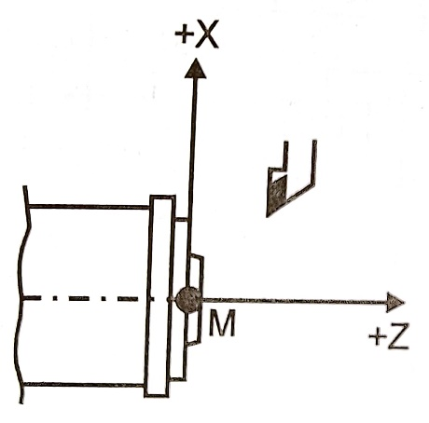
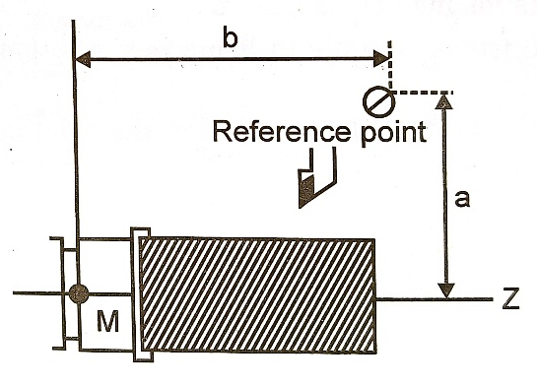
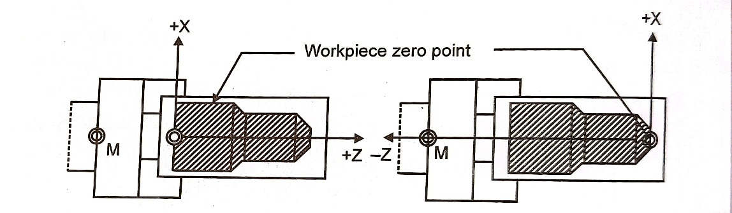
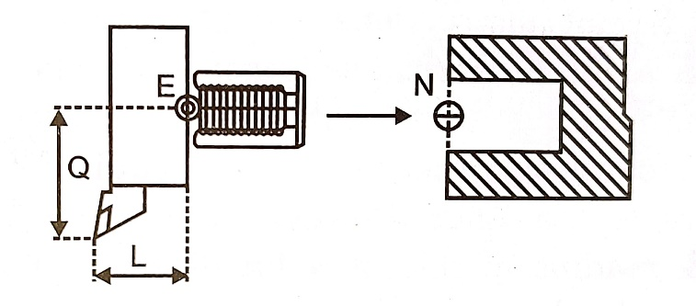
Zero Point
Machine tool zero point
Program zero point
Workpiece zero point
Tool zero point

Slide 10
Part Programming Format
Tab sequential format (NC only)
Fixed Format (NC only)
Word address format (NC & CNC)
Compatible format (NC & CNC)
N010 G00 X100.00 Y200 Z10 F30 M08
010 > 00 > 100.00 >200 > 10 > 30 > 08
N010 G01 X10 Y20 Z30 F30 S1000
010 01 10 20 30 30 1000
This format is standardized by EIA and there are no TAB codes used.
N01 G01 X30 Y20 Z10 S500 F80 T01 M01
It is similar to word address format, but TAB codes are added in it.

Slide 11
Part Programme Structure
N03 G02 X300 Y200 Z10 I100 J-10 K20 S450 F80 T03 M01#
Block No
Feed speed
Spindle speed
Preparatory Code
Center position along X-axis Curved paths
Center position along Y-axis Curved paths
Center position along Z-axis Curved paths
Tool Specification
Location along Y-axis
Miscellaneous code
Location along X-axis
Location along Z-axis

Slide 12
G Codes
Code | Description | Code | Description | Code | Description
G00* | Rapid positioning | G43 | Tool length compensation in +Z | G82 | Drilling cycle, counter boring
G01 | Linear interpolation | G44 | Tool length compensation in -Z | G83 | Peck drilling cycle
G02 | Circular interpolation CW | G49* | Tool length compensation cancel | G84 | Tapping cycle
G03 | Circular interpolation CCW | G52 | Local coordinate system setting | G84.2 | Rigid tapping cycle
G04 | Dwell, Exact stop | G53 | Positioning in machine coordinate | G85 | Boring cycle
G09 | Exact stop | G54* | Work coordinate system 1 select | G86 | Boring cycle
G10 | Programmable data input | G55 | Work coordinate system 2 select | G87 | Back boring cycle
G11* | Programmable data input cancel | G56 | Work coordinate system 3 select | G88 | Boring cycle
G17* | XY plane selection | G57 | Work coordinate system 4 select | G89 | Boring cycle
G18 | ZX plane selection | G58 | Work coordinate system 5 select | G90* | Select absolute command
G19 | YZ plane selection | G59 | Work coordinate system 6 select | G91 | Select incremental command
G20 | Select inch unit | G61 | Exact stop mode | G92 | Programming of absolute zero point
G21 | Select metric unit in mm | G64* | Cutting mode | G93 | Inverse time feed
G27 | Reference point return check | G65 | Macro call | G94* | Per minute feed
G28 | Return to reference point | G66 | Macro modal call | G95 | Per revolution feed
G29 | Return from reference point | G67 | Macro modal call cancel | G96 | Constant surface speed control
G30 | Return to 2 nd reference point | G73 | High speed peck drilling cycle | G97* | Constant surface speed control cancel
G33 | Thread Cutting | G74 | Counter tapping cycle | G98* | Return to initial point in canned cycle
G40* | Cutter compensation cancel | G76 | Fine boring cycle | G99 | Return to R point in canned cycle
G41 | Cutter compensation left | G80* | Canned cycle cancel
G42 | Cutter compensation right | G81 | Drilling cycle, spot boring

Slide 13
M-Codes
M00 Program Stop
M01 Program Optional Stop
M02 End the Program
M03 Spindle On Clockwise, Laser, Flame, Power ON
M04 Spindle On Counter Clockwise
M05 Spindle Stop, Laser, Flame, Power OFF
M06 Tool Change
M08 Coolant On
M09 Coolant Off
M10 Reserved for tool height offset
M13 Spindle On, Coolant On
M30 End the Program when macros are used
M91 Readout Display Incremental
M92 Readout Display Absolute
M97 Go to or jump to line number
M98 Jump to macro or subroutine
M99 Return from macro or subroutine
M100 Machine Zero Reset
M199 Mid program start

Slide 14
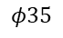
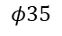
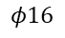
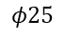
Simple Programming for Rational Components
+X
Part Programme of Turning operation
%1000; (Main Programme)
N01 G54 G90 G71 G94 M03 S800; (Parameter Settings)
N05 G01 X-12.5 Z0 F2; (Facing the job)
N10 G00 Z1; (Retrieval of tool)
N15 G00 X00; (Tool Clearance)
N20 G01 Z-100; (Starting cut)
N25 G00 X1 Z1; (Clearance position)
N30 G00 X-2; (Position of cut)
N35 G01 Z-60; (Cutting length)
N40 G00 X-1 Z1; (Retrieval of tool)
N45 G00 X-3; (Position of cut)
N50 G01 Z-60; (Cutting length)
N55 G00 X-2 Z1; (Retrieval of tool)
N60 G00 X-4; (Position of cut)
N65 G01 Z-60; (Cutting length)
N70 G00 X-3 Z1; (Retrieval of tool)
N75 G00 X-4.5; (Position of cut)
N80 G01 Z-60; (cutting length)
N85 G00 X5 Z5; (Final position of tool)
N90 M02; (End of Programme)
+Z
$$φ35$$
(0,0)
Tool
$$φ35$$
$$φ25$$
$$φ16$$
60
(0,0)
100

Slide 15
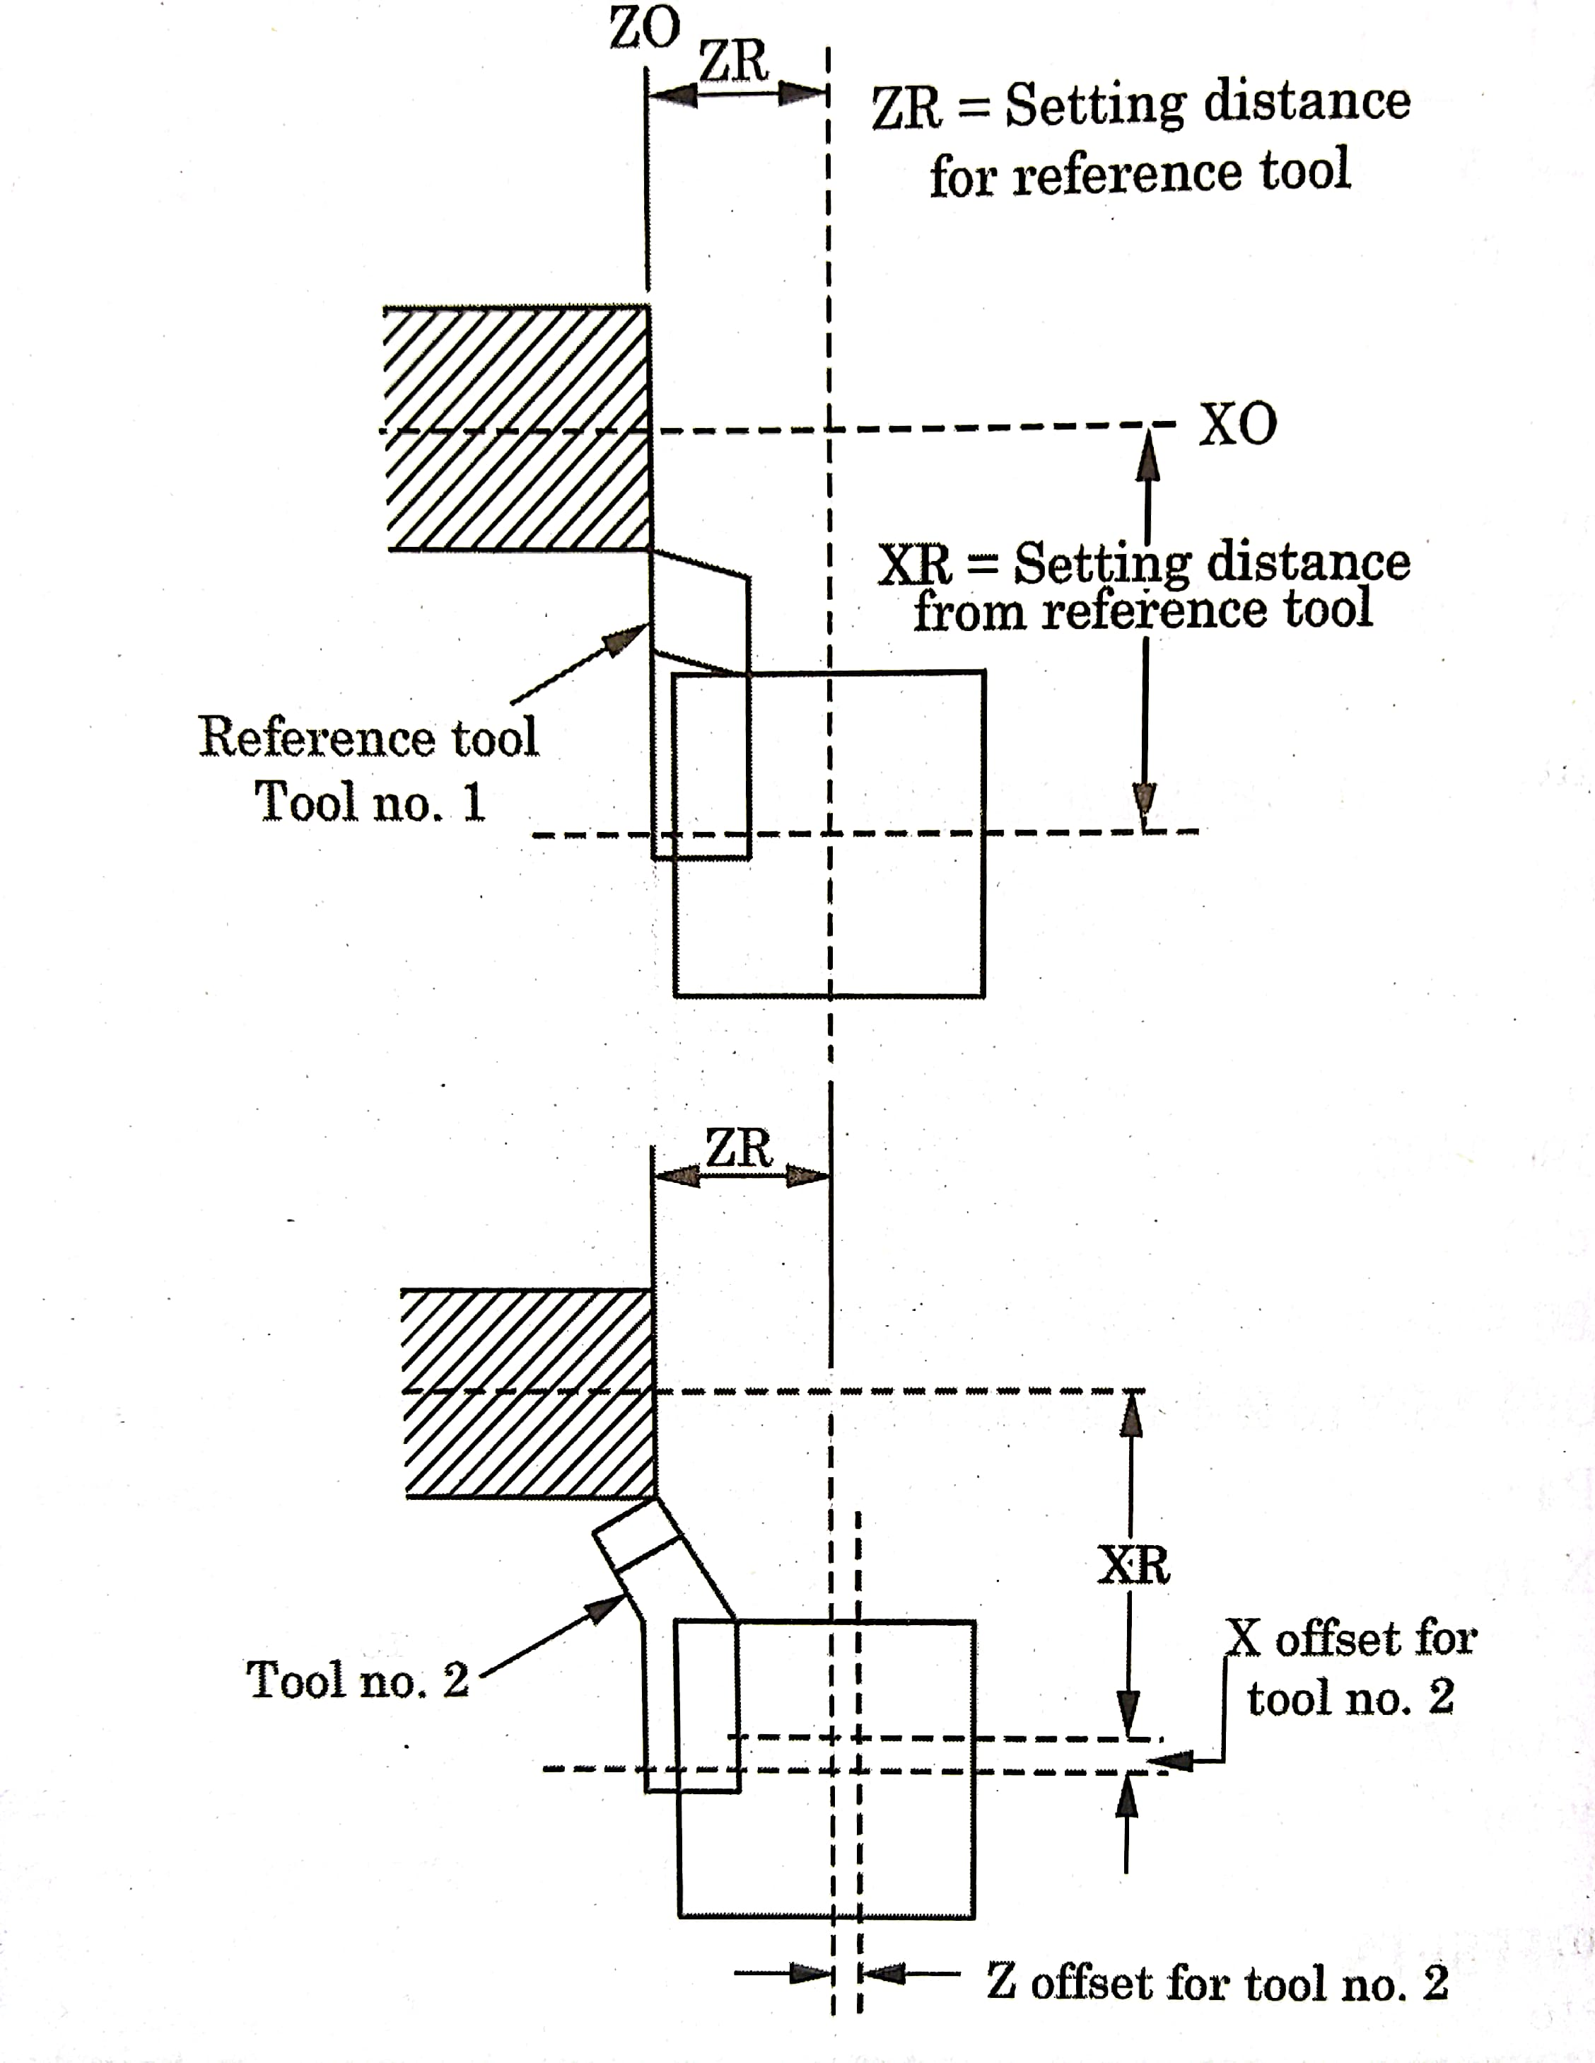
Tool Offsets: Correction for dimensions of the tools and movements of the workpiece has to be incorporated to give the exact machining of the component. This is known as tool offset.
Normally, it is found that the size of the workpiece is not within the tolerance due to wear of the tool; it is then possible to edit the value of offsets to obtain the correct size, this is known as tool wear compensation.

Slide 16
Tool Compensation
Cutter radius Compensation
Tool wear compensation
This code command allows the programmer to ignore the cutting tool’s radius or diameter during programming
Similar to the cutter radius compensation, tool wear compensation is also used in part programming.

Slide 17
Canned Cycles: - Canned cycle or fixed cycle may be defined as a set of instructions, inbuilt or stored in the system memory, to perform a fixed sequence of operations. A canned cycles defines a series of machining sequence for drilling, boring, tapping etc. The canned cycle G81 to G89 are stored as subroutines L81 to L89. These cycles are used for repetitive and commonly used machining operations.
Sub Routines: - These are also known as subprograms, a very powerful saving method. The subroutines provide the capability of programming certain program that are repeated frequently. They are independent programmes that can be called any time and any number of times.
Do Loops: - The Do loops gives the facility to programmer to jump back to an earlier part of programme and execute the intervening programme and not separately like subroutines. It is given in the main program itself.
Refer to book for more details

Slide 18
Thank You

